Slide 1
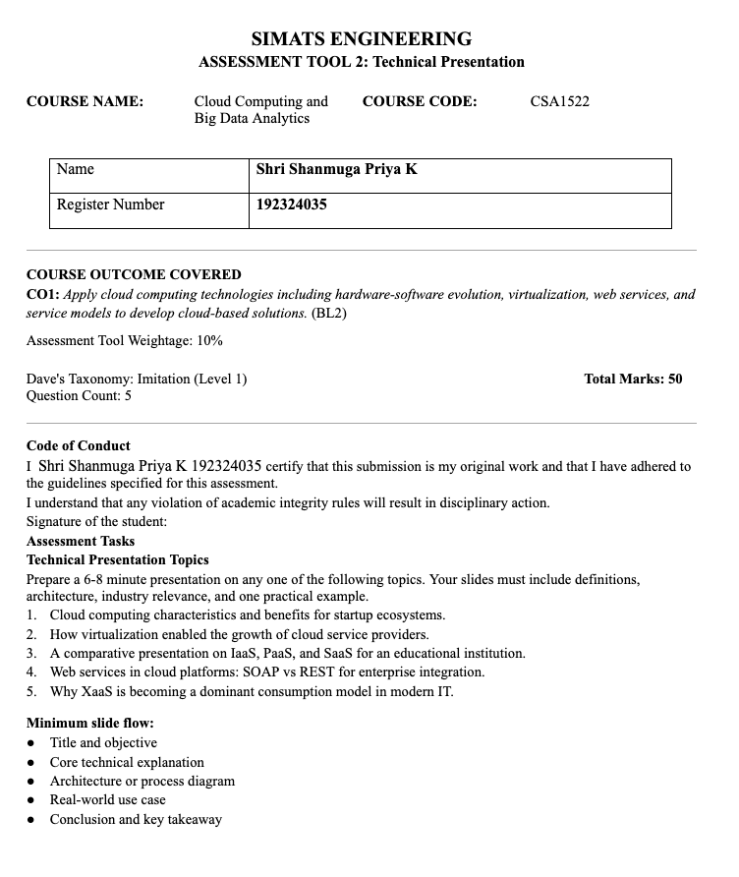

Slide 2

CSA1522-Cloud Computing and Big Data Analytics
A Comparative Analysis of IaaS, PaaS, and SaaS for Educational Institutions
Presented by:
Shri Shanmuga Priya K – 192324035
Lakshmi A -192373066
Guided by: Rajaram P

Slide 3


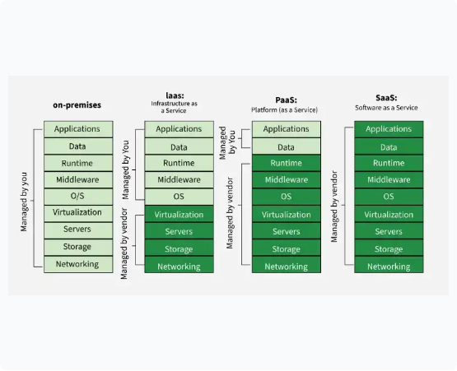
The Cloud Control Spectrum
The primary difference between cloud service models lies in the division of responsibility between the institution and the cloud provider.
•
On-Premises: The institution manages the entire stack, from physical hardware to applications. High control, but high capital and maintenance costs.
•
Infrastructure as a Service (IaaS): The provider manages physical hardware and virtualization. You manage OS, data, and applications.
•
Platform as a Service (PaaS): The provider handles infrastructure and OS/runtime environments. You focus on application code and data.
•
Software as a Service (SaaS): The provider manages the entire stack. You simply consume the application as a user.

Slide 4

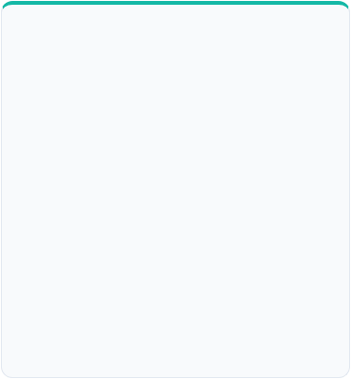







Defining the Core Cloud Models
IaaS
PaaS
SaaS
Infrastructure as a Service
Platform as a Service
Software as a Service
Provides foundational computing resources (virtual machines, networking, storage) on demand over the internet.
Delivers a managed framework for developers to build, test, and deploy custom applications without infrastructure headaches.
Delivers fully managed, ready-to-use software applications over the internet, typically accessed via a web browser.

Slide 5

IaaS in Action
Research Computing Environments
The Challenge: A university physics department needs massive computing power for a short-term data analysis project, but buying physical servers is cost-prohibitive.
The IaaS Solution: The IT team provisions high-performance Virtual Machines (VMs) and block storage on an IaaS platform (like AWS or Azure). The researchers install their specialized OS and custom analysis software.
The Benefit: Complete control over the specific environment required, rapid provisioning, and they only pay for the compute time used during the research phase.

Slide 6


PaaS in Action
Custom Student Portal Development
The Challenge: The university wants to build a unique, custom mobile application for students to track shuttle buses and check dining hall menus, but lacks a large IT operations team.
The PaaS Solution: Student developers and IT staff use a PaaS environment (like Heroku or Google App Engine). They write the code and connect to a managed database provided by the platform.
The Benefit: Faster time-to-market. The platform automatically handles security patching of the OS, load balancing during high traffic times (like lunch), and infrastructure management.

Slide 7
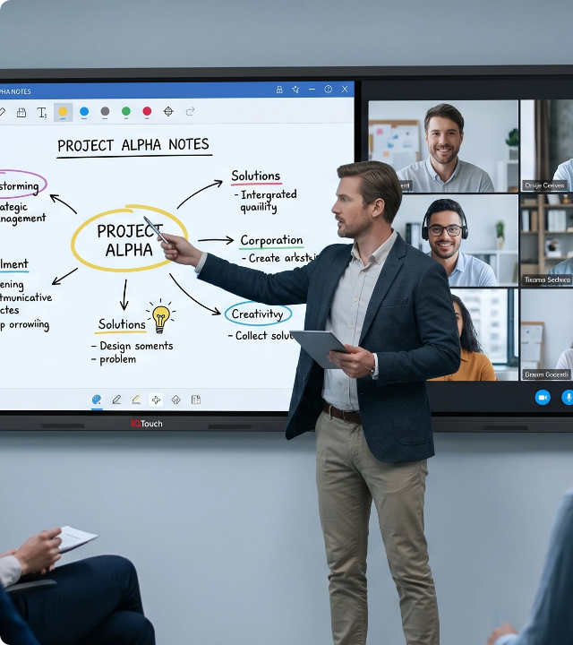
SaaS in Action
Learning Management Systems
The Challenge: Providing a robust, always-available platform for course materials, grading, and student communication across the entire university.
The SaaS Solution: The university subscribes to a cloud-hosted Learning Management System (LMS) like Canvas or Blackboard.
The Benefit: Zero infrastructure to maintain. The provider handles all software updates, security patches, backups, and scaling during peak exam periods. Users simply log in and use the tools.

Slide 8
Summary: Choosing the Right Model
Feature | IaaS (Infrastructure) | PaaS (Platform) | SaaS (Software)
Primary User | IT Administrators, Network Architects | Software Developers | End Users (Students, Faculty, Staff)
Level of Control | High (OS, Network, Data, Apps) | Medium (Data, Apps) | Low (User Access, App Configuration)
Management Burden | High (Requires specialized IT staff) | Medium (Focus on coding) | Low (Managed by vendor)
Time to Value | Days to Weeks (Configuration required) | Hours to Days (Focus on deployment) | Immediate (Ready to use)
Educational Examples | Hosting legacy student information databases | Developing a custom campus navigation app | Email (Google Workspace), LMS (Canvas)

Slide 9
Thank You

